Slide 1
LECTURE 18 Normal Distribution

Slide 2
What you will learn in this lecture:
The Normal distribution
Mean and standard deviation
Standard normal distribution
Normal approximation to binomial

Slide 3
Normal Distribution: The Bell-Shaped Curve
The bell-shaped curve, also known as normal curve, is widely used to approximate many phenomena.
The normal distribution allows us to calculate probabilities associated with observed sample results when we are dealing with CONTINUOUS outcomes.

Slide 4
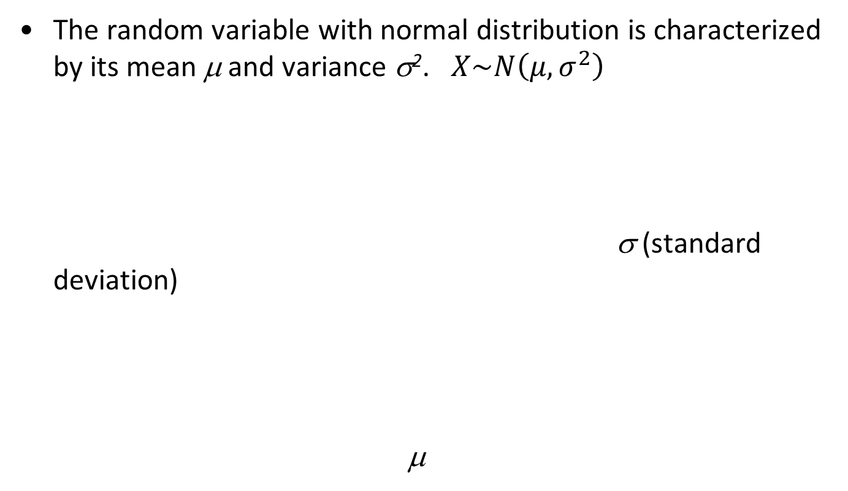
Normal Distribution: The Bell-Shaped Curve
The random variable with normal distribution is characterized by its mean μ and variance σ². $X\sim N\left(μ,σ^{2}\right)$
σ (standard deviation)
μ
f(x)
x

Slide 5

Normal Distribution
The pdf for a Normal random variable X is given by
$f\left(x\right)=\frac{1}{\sqrt{2πσ^{2}}}e^{−\frac{{\left(x−μ\right)}^{2}}{2σ^{2}}}$

Slide 6
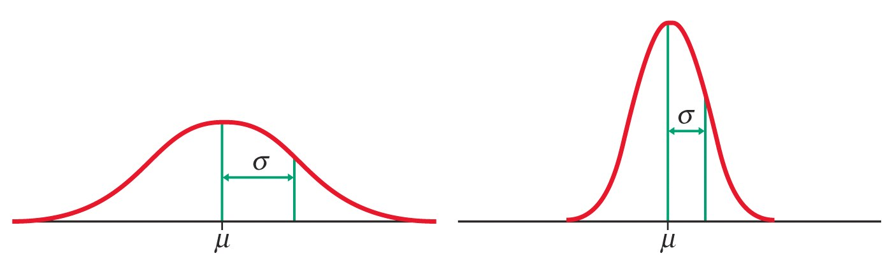
Normal Distribution
Knowing the mean (µ) and standard deviation (σ) allows us to make various conclusions about Normal distributions.
6

Slide 7
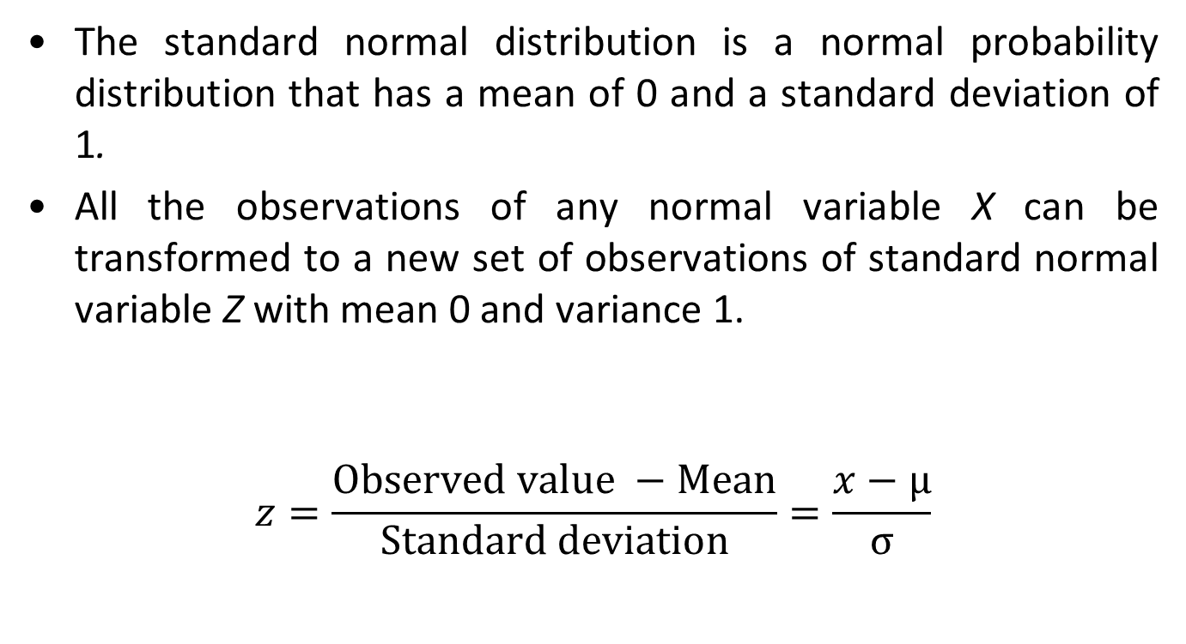

Standard Normal Distribution ($Z\sim N(0,1))$
The standard normal distribution is a normal probability distribution that has a mean of 0 and a standard deviation of 1.
All the observations of any normal variable X can be transformed to a new set of observations of standard normal variable Z with mean 0 and variance 1.
$$z=\frac{Observed value −Mean}{Standard deviation}=\frac{x−μ}{σ}$$
7

Slide 8
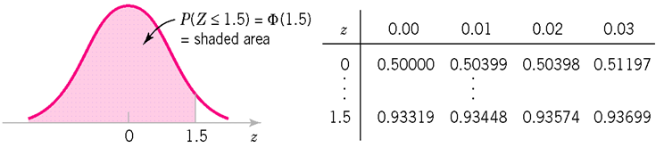
Standard Normal Distribution
We can find the areas under the standard normal curve by referring to Standard Normal Table which gives cumulative probabilities Φ(z).
Standard Normal curve areas, Φ(z) = P(Z ≤ z)

Slide 9
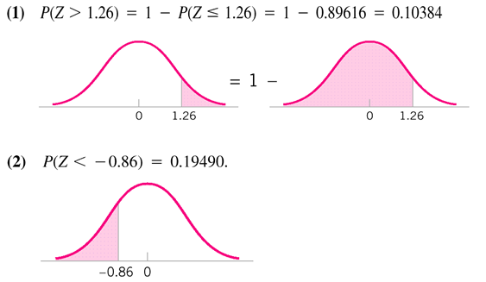
Standard Normal Distribution

Slide 10
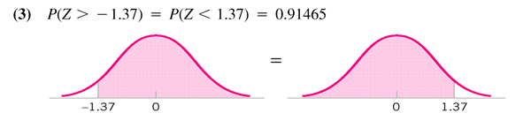
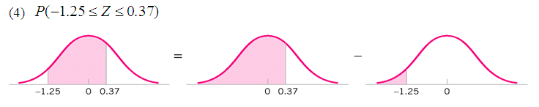
Standard Normal Distribution

Slide 11

Converting Non-Standard Normal Distribution
If X has a normal distribution with mean μ and standard deviation σ, then has a standard normal distribution.
Thus,
$$P\left(a≤X≤b\right)=P\left(\frac{a−μ}{σ}≤Z≤\frac{b−μ}{σ}\right)=P\left(Z≤\frac{b−μ}{σ}\right)−P\left(Z<\frac{a−μ}{σ}\right)$$
$P\left(X≤a\right)=P\left(Z≤\frac{a−μ}{σ}\right)$
$P\left(X≥b\right)=P\left(Z≥\frac{b−μ}{σ}\right)=1−P\left(Z<\frac{b−μ}{σ}\right)$
11

Slide 12
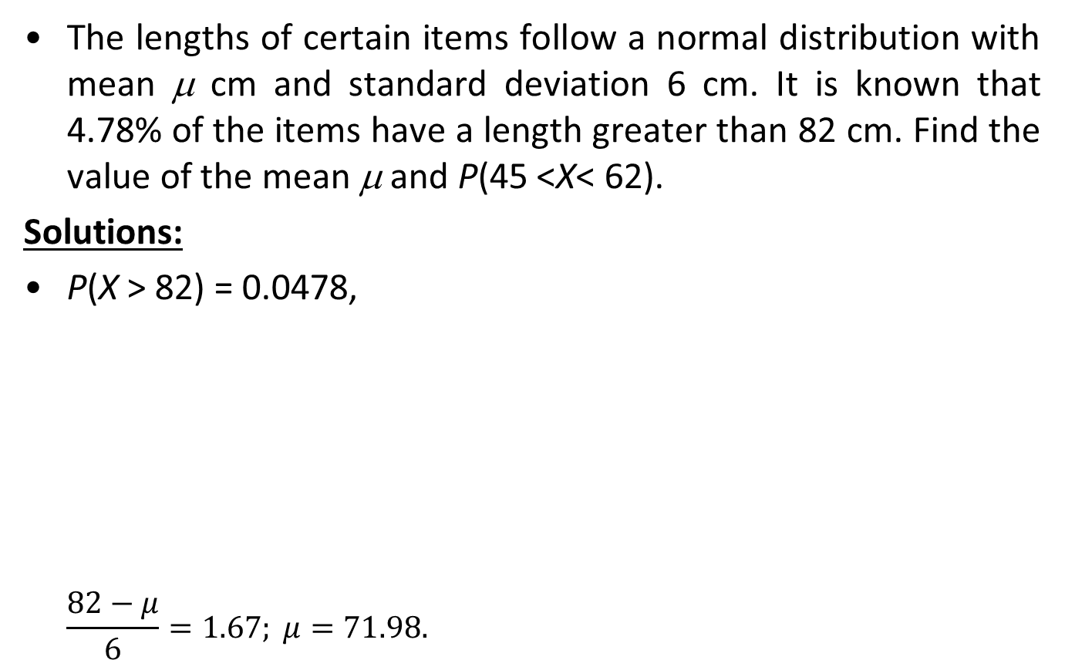
Example 1
The lengths of certain items follow a normal distribution with mean μ cm and standard deviation 6 cm. It is known that 4.78% of the items have a length greater than 82 cm. Find the value of the mean μ and P(45 <X< 62).
Solutions:
P(X > 82) = 0.0478,
$$\frac{82−μ}{6}=1.67; μ=71.98.$$
P(45 < X < 62)
= P(-4.497 < Z < -1.663)
= 0.0485
12
Notes:
12

Slide 13
Example 2
The masses of articles produced in a particular workshop are normally distributed with mean μ and standard deviation σ.
5% of the articles have a mass greater than 85g and 10% have a mass less than 25g. Find
1) μ and σ.
2) P(X > 60)
3) a, given that P( a < X < 74.65) = 0.75
13
13
Notes:
13

Slide 14
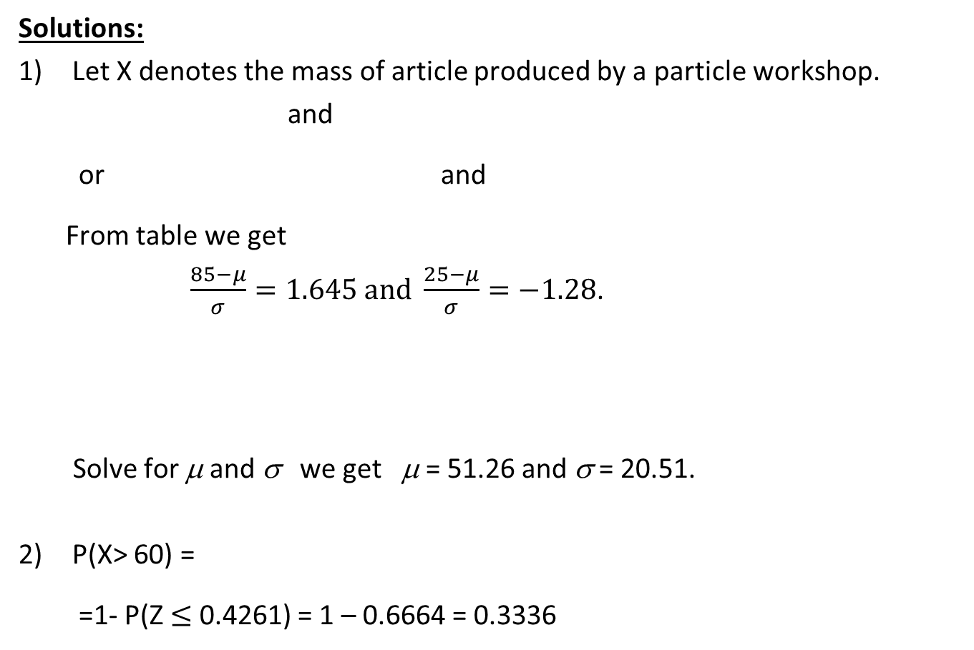
Example 2 (Cont.)
Solutions:
Let X denotes the mass of article produced by a particle workshop.
and
or and
From table we get
$\frac{85−μ}{σ}=1.645 and \frac{25−μ}{σ}=−1.28$.
Solve for μ and σ we get μ = 51.26 and σ = 20.51.
P(X> 60) =
=1- P(Z $≤$ 0.4261) = 1 – 0.6664 = 0.3336
14
Notes:
14

Slide 15
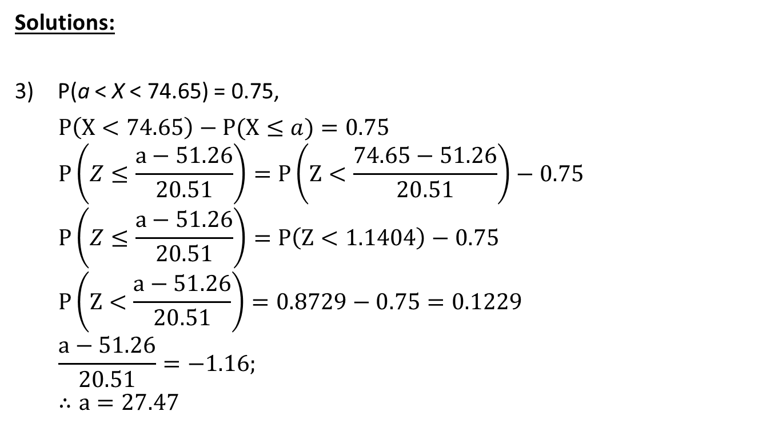
Example 2 (Cont.)
Solutions:
P(a < X < 74.65) = 0.75,
$$P\left(X<74.65\right)−P(X≤a)=0.75$$
$$P\left(Z≤\frac{a−51.26}{20.51}\right)=P\left(Z<\frac{74.65−51.26}{20.51}\right)−0.75$$
$$P\left(Z≤\frac{a−51.26}{20.51}\right)=P\left(Z<1.1404\right)−0.75$$
$$P\left(Z<\frac{a−51.26}{20.51}\right)=0.8729−0.75=0.1229$$
$$\frac{a−51.26}{20.51}=−1.16;$$
$$∴a=27.47$$
15
Notes:
15

Slide 16
Normal Approximation to the Binomial
The binomial distribution shape is close to symmetrical for large n and p close to 0.5.
If a large sample is selected from a population of binary values, the probabilities of the observed outcomes can be approximated using the normal distribution N(μ, σ²) where μ = np, and σ² = np(1 – p).
16
Notes:
16

Slide 17
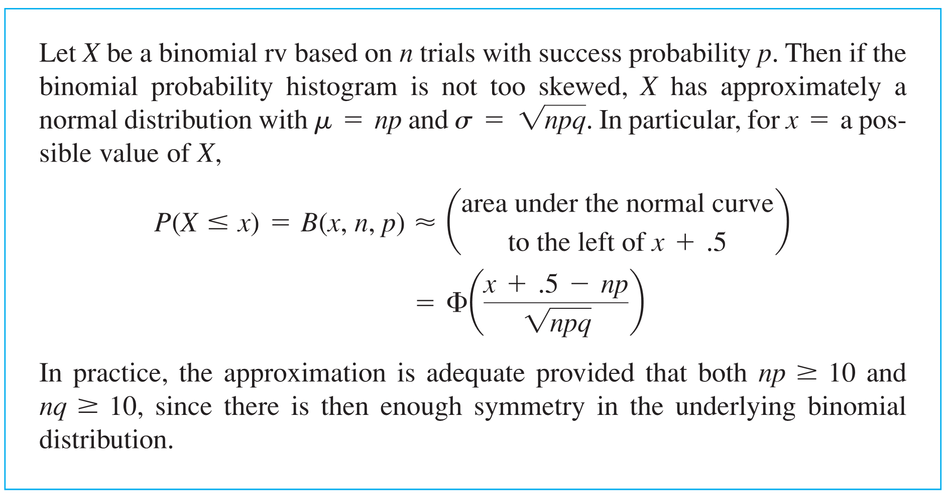
Approximating the Binomial Distribution
Proposition

Slide 18
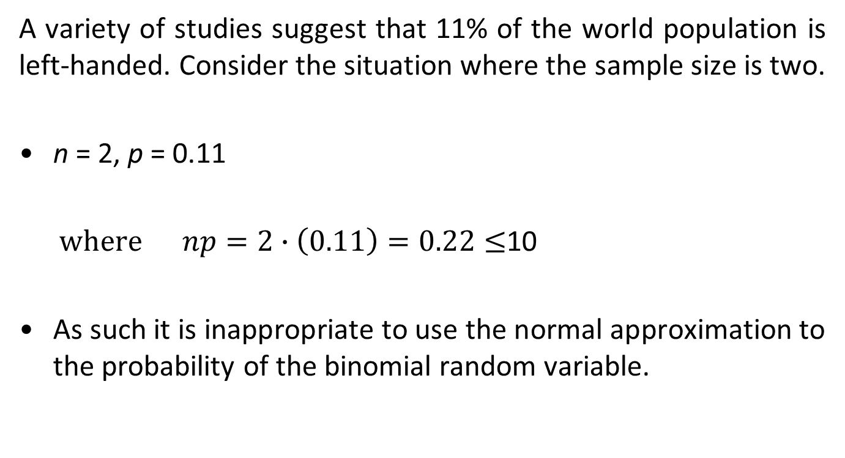
Example 3
A variety of studies suggest that 11% of the world population is left-handed. Consider the situation where the sample size is two.
n = 2, p = 0.11
where $np=2∙\left(0.11\right)=0.22≤$10
As such it is inappropriate to use the normal approximation to the probability of the binomial random variable.
18
18
Notes:
18

Slide 19
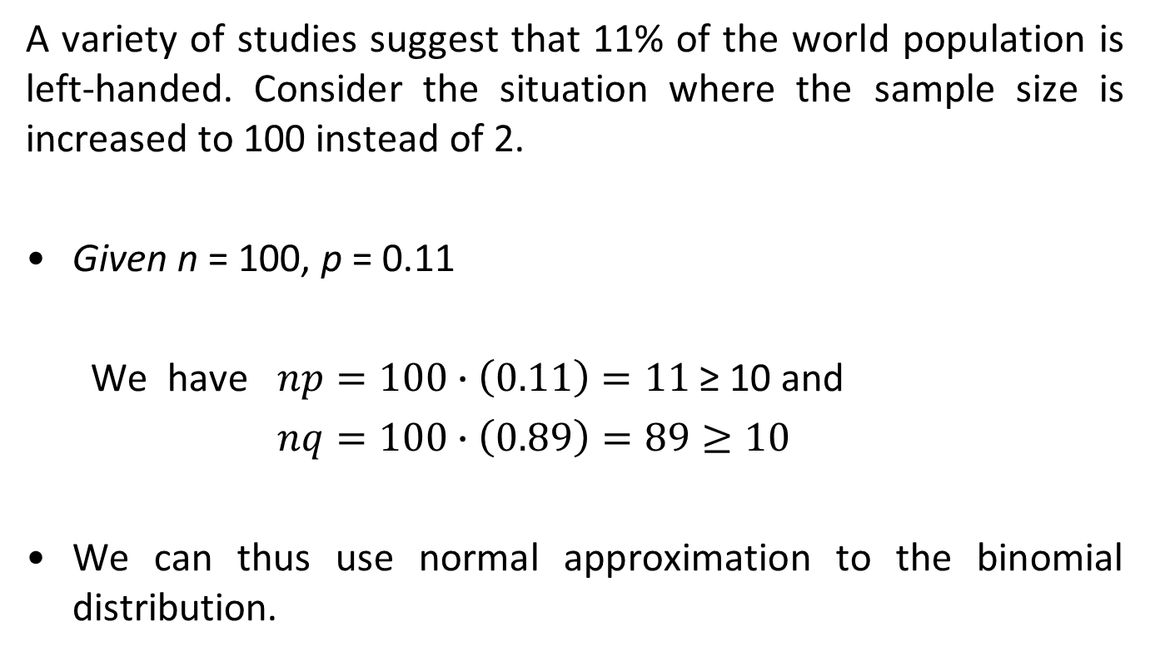
Example 4
A variety of studies suggest that 11% of the world population is left-handed. Consider the situation where the sample size is increased to 100 instead of 2.
Given n = 100, p = 0.11
We have $np=100∙\left(0.11\right)=11$ ≥ 10 and
$nq=100∙\left(0.89\right)=89≥10$
We can thus use normal approximation to the binomial distribution.
19
19
Notes:
19

Slide 20
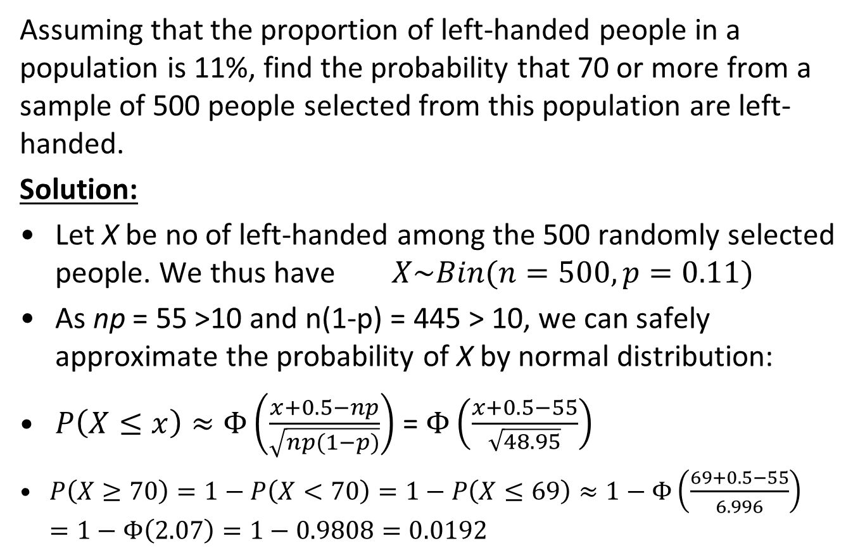
Example 5
Assuming that the proportion of left-handed people in a population is 11%, find the probability that 70 or more from a sample of 500 people selected from this population are left-handed.
Solution:
Let X be no of left-handed among the 500 randomly selected people. We thus have $X\sim Bin(n=500,p=0.11)$
As np = 55 >10 and n(1-p) = 445 > 10, we can safely approximate the probability of X by normal distribution:
$P\left(X≤x\right)≈Φ\left(\frac{x+0.5−np}{\sqrt{np(1−p)}}\right)$ = $Φ\left(\frac{x+0.5−55}{\sqrt{48.95}}\right)$
$P\left(X≥70\right)=1−P\left(X<70\right)=1−P\left(X≤69\right)≈1−Φ\left(\frac{69+0.5−55}{6.996}\right)$
$$=1−Φ\left(2.07\right)=1−0.9808=0.0192$$
20
20
Notes:
20

Slide 21
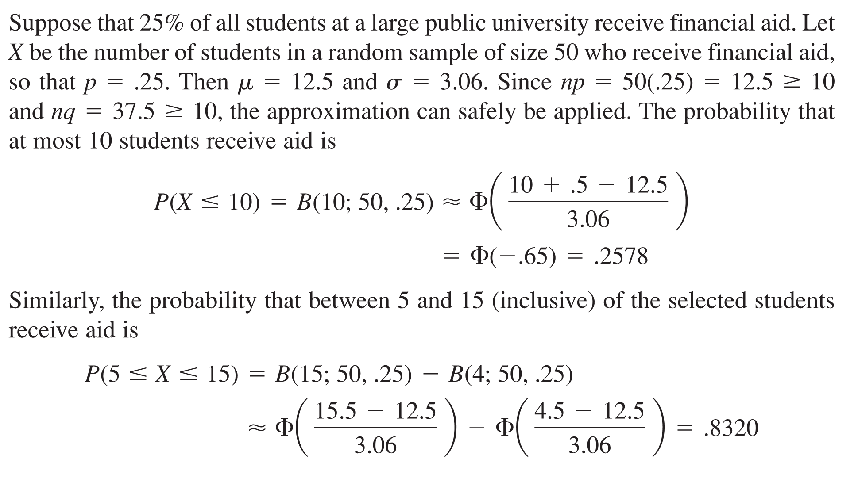
Example 6

Slide 22
Summary
Materials discussed in this lecture
The Normal distribution
The Standard Normal distribution
Normal approximation to Binomial
22
22
Notes:
22

Slide 23
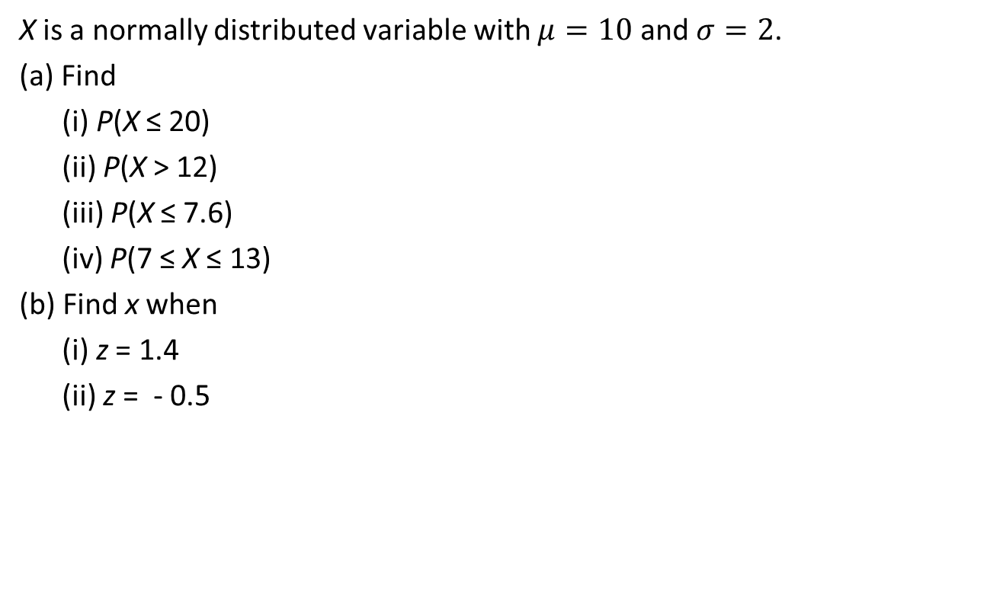
Exercise 1
X is a normally distributed variable with $μ=10$ and $σ=2$.
(a) Find
(i) P(X ≤ 20)
(ii) P(X > 12)
(iii) P(X ≤ 7.6)
(iv) P(7 ≤ X ≤ 13)
(b) Find x when
(i) z = 1.4
(ii) z = - 0.5
23
23
Notes:
23

Slide 24
Exercise 2
For a certain type of computers, the length of time between charges of the battery is normally distributed with a mean of 50 hours and a standard deviation of 15 hours. James owns one of these computers and wants to know the probability that the length of time will be between 50 and 70 hours.
24
24
Notes:
24

Slide 25
Exercise 3
The length of life of an instrument produced by a machine has a normal distribution with a mean of 12 months and standard deviation of 2 months. Find the probability that an instrument produced by this machine will last
less than 7 months
between 7 and 12 months
25
25
Notes:
25

Slide 26
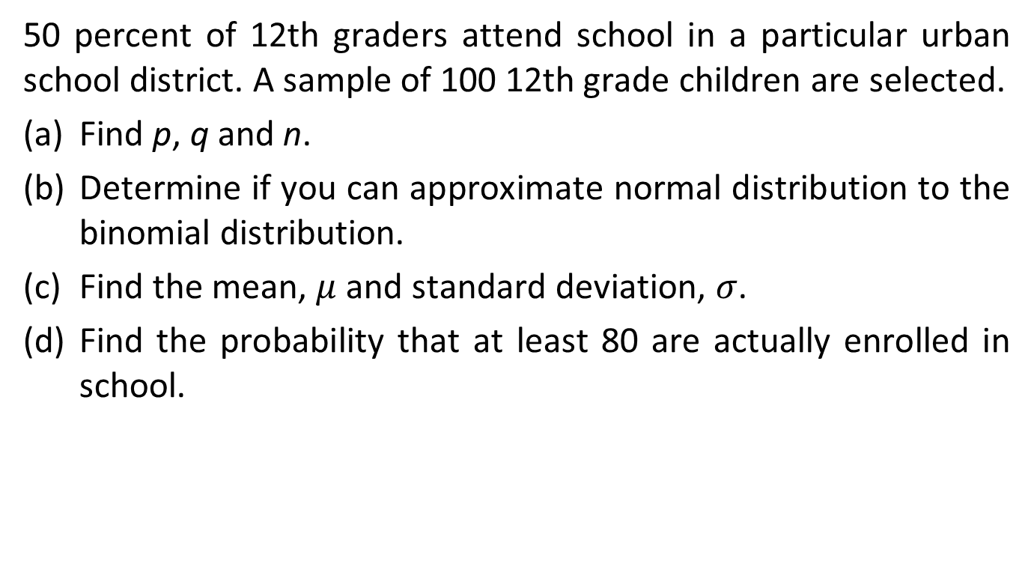
Exercise 4
50 percent of 12th graders attend school in a particular urban school district. A sample of 100 12th grade children are selected.
Find p, q and n.
Determine if you can approximate normal distribution to the binomial distribution.
Find the mean, $μ$ and standard deviation, $σ$.
Find the probability that at least 80 are actually enrolled in school.
26
26
Notes:
26

